Slide 1
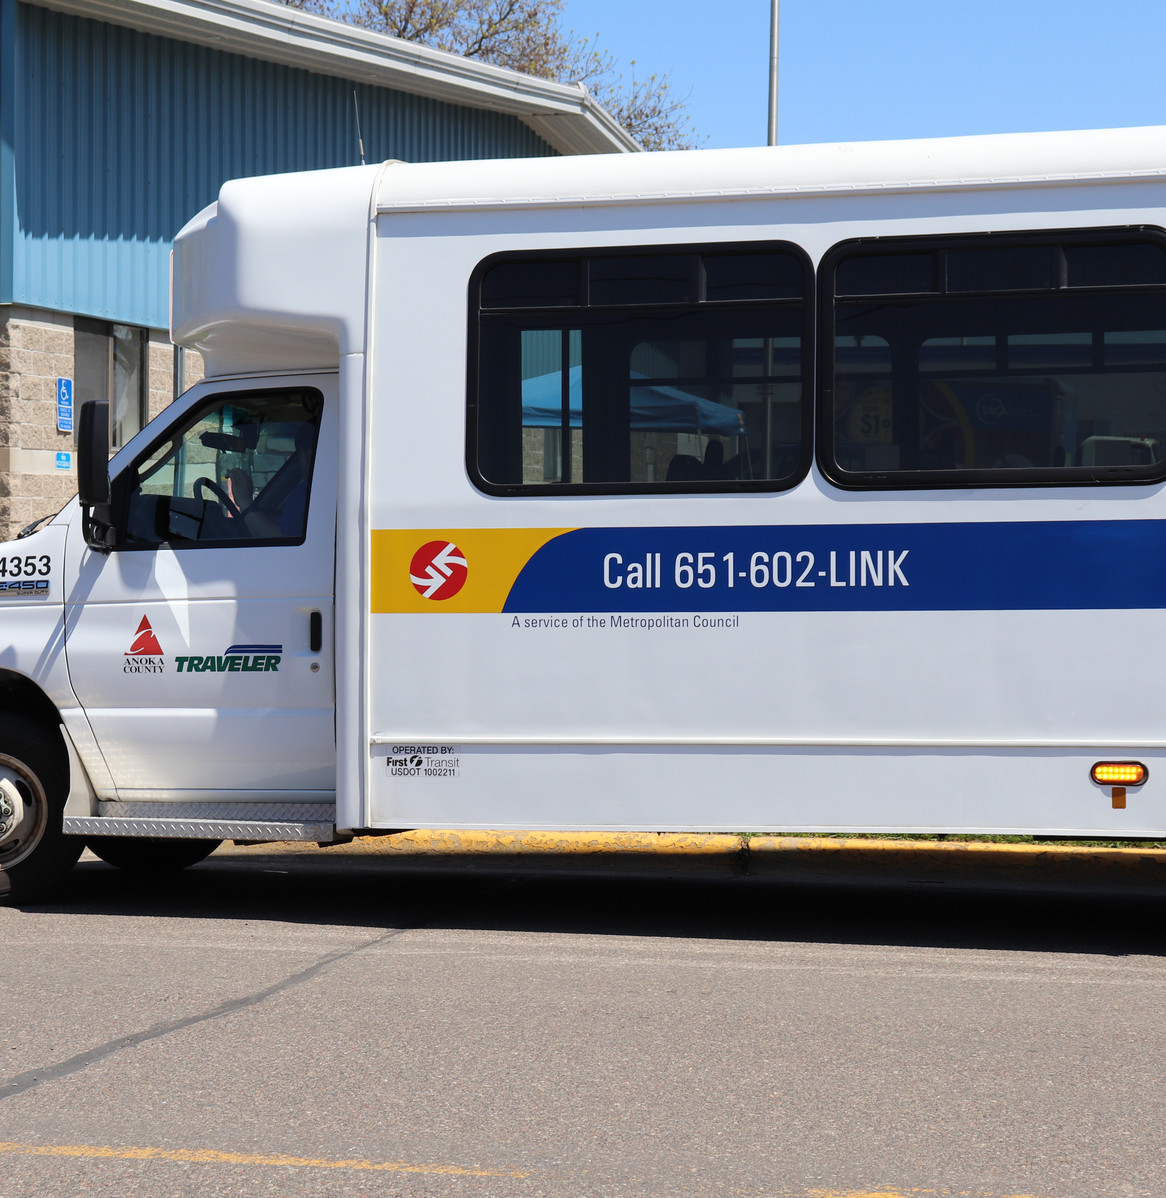
Anoka County Transit Link (The Traveler)
Presented by Anne Walter
Anoka County
Transit Services Assistant

Slide 2
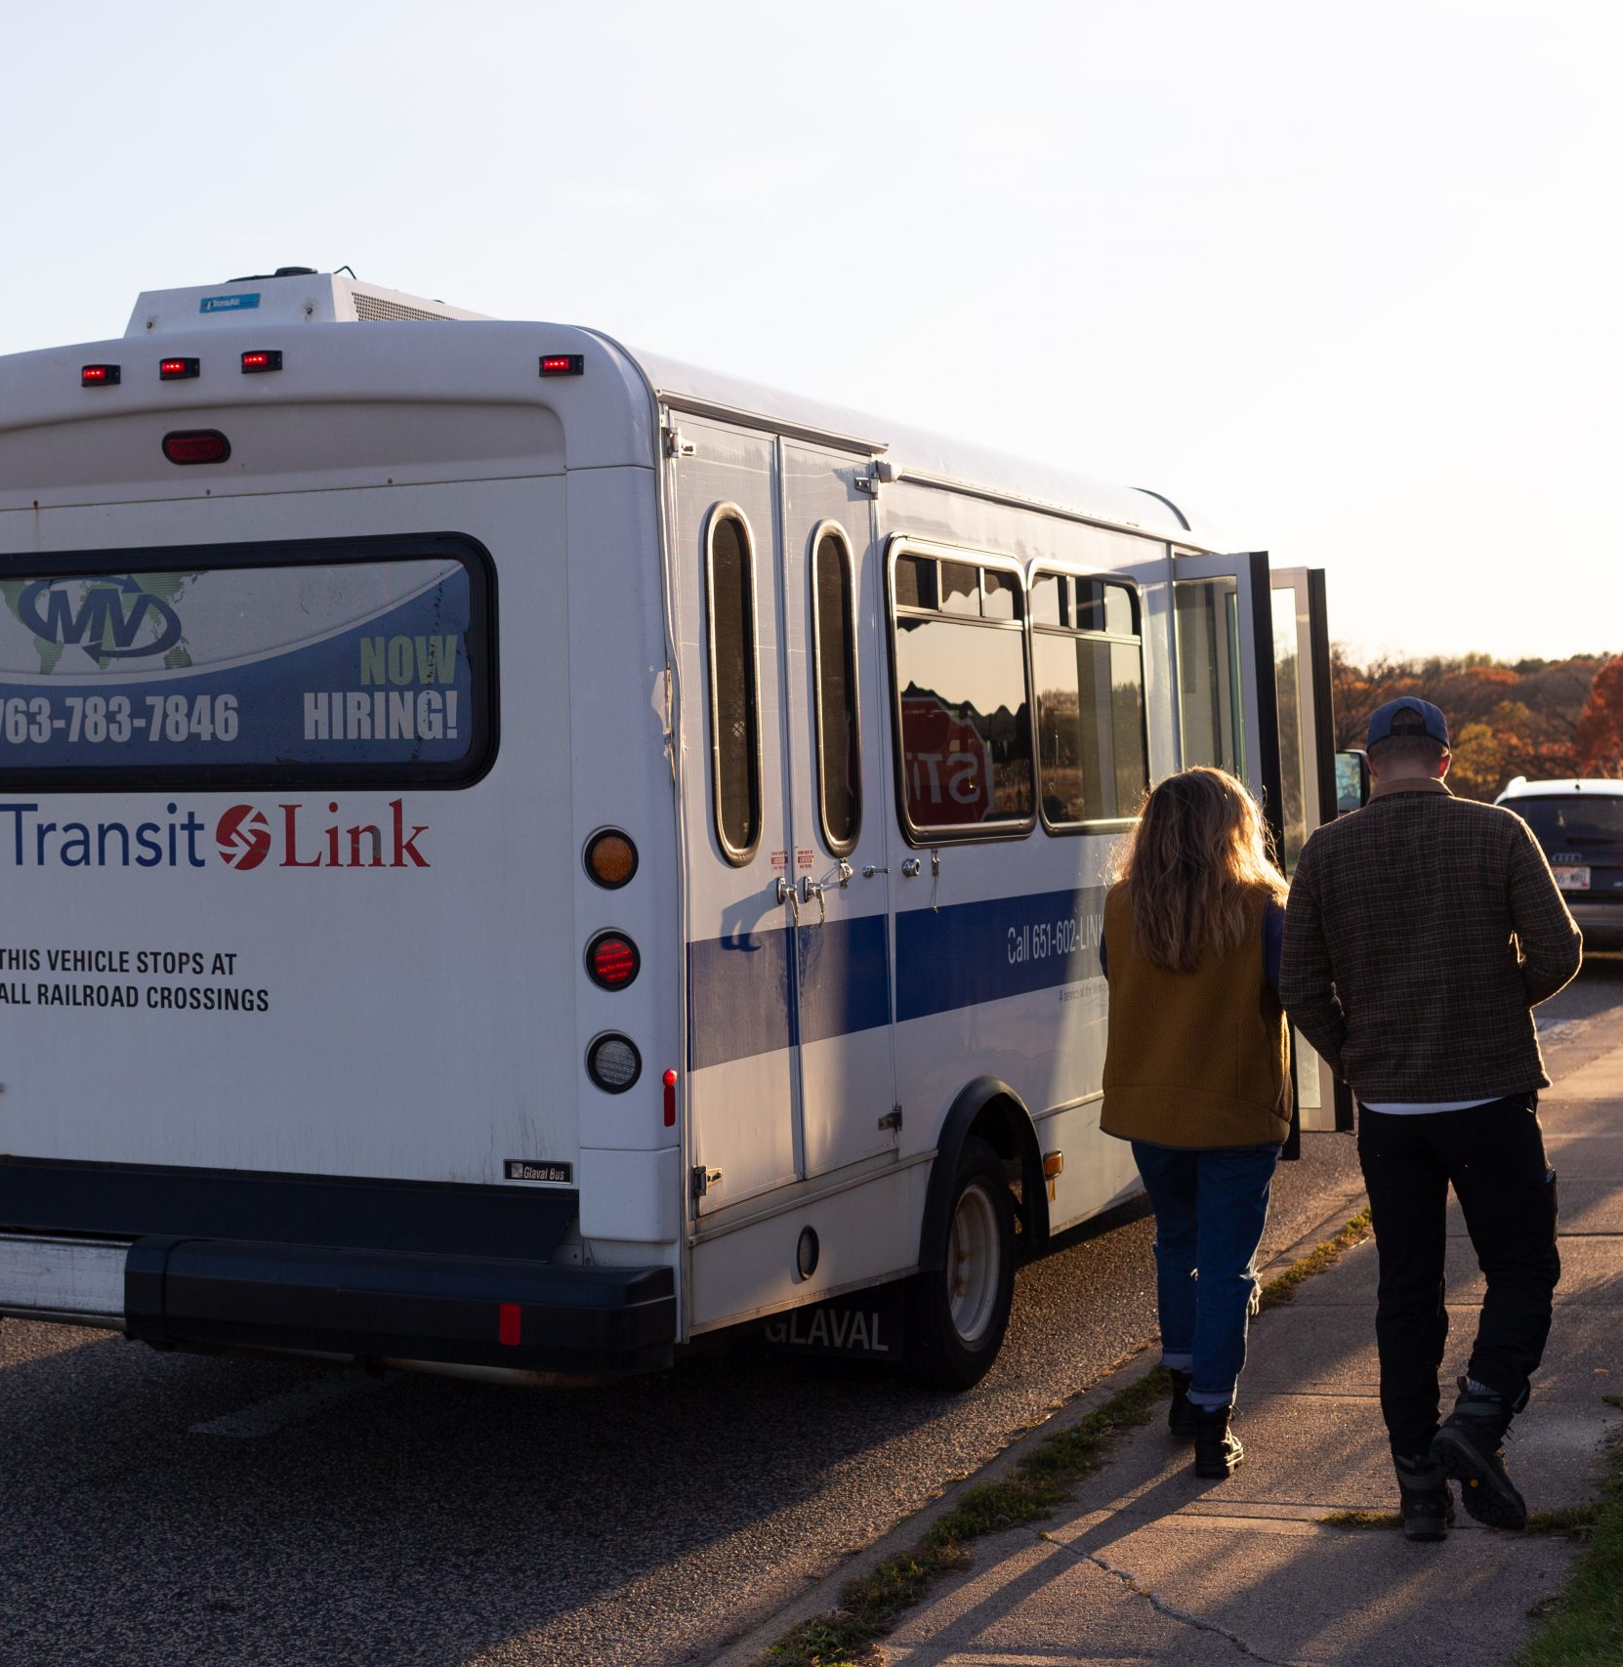
What is Transit Link?
Transit Link is a curb-to-curb service for the public that operates on weekdays throughout the seven-county metropolitan area.
It is available wherever a fixed route bus does not operate and is a shared ride service.
Most trips are not shared at this time due to COVID. Mandatory social distancing is in place on all AC Transit Link buses. We can safely distance three passengers at a time, if needed.
Riders Guide can be found at www.transitlinktc.org

Slide 3
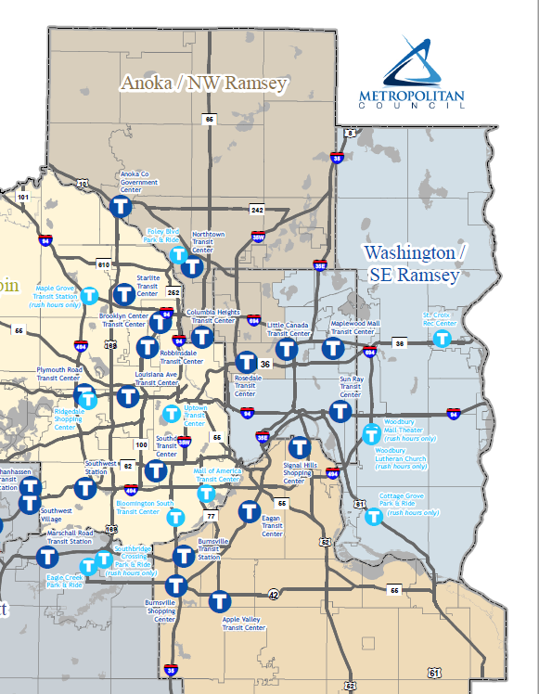
Where does it serve Anoka County?
Transit Link Operates in
Andover
Anoka
Bethel
Blaine
Centerville
Circle Pines
Columbia Heights
Columbus
Coon Rapids
East Bethel
Fridley
Ham Lake
Hilltop
Lexington
Lino Lakes
Linwood Township
Nowthen
Oak Grove
Ramsey
Spring Lake Park
St. Francis

Slide 4

RESERVING A TRANSIT LINK RIDE
You may reserve a ride up to five days business days in advance. Rides are not prioritized by trip purpose. Rides are subject to availability.
Same day rides may be available if the schedule allows. You must look out at least two hours in advance for a same-day request. If you want a ride at 10:00 am, please call no later than 8:00 am.
If a scheduled time is not available, you may be put on standby. Please call back the day before your ride, between 1:00 pm – 3:00 pm, to determine your ride time.
Reservations are accepted Monday through Friday from 7:00 am to 3:30 pm.
Call 651-602-5465 (LINK) for Transit Link reservations. To schedule a ride in Anoka County, press 1, 1 and 1 again.
4

Slide 5

Scheduling a Trip
Please have the following information available:
Name
Day and date of the requested trip
Time you’d like to be picked up.
Appointment time at your destination.
Detailed pick-up address, including apt. number, building name, or description
Detailed destination address
Companions or PCA traveling with you
Type of mobility device, if you use one
Each trip is screened for a fixed route solution
You must schedule separate trips if you need a ride both to and from your destination.
5

Slide 6
Transit Link Service Hours
Standard service hours are weekdays, Monday through Friday, from 6:00 am to 7:00 pm. Service is not available on Saturday or Sunday.
Seasonal Service
Transit Link will not provide rides shorter than the seasonal walking distances.
November to March
Trip origins and destinations must be more than .25 miles walking distance from a regular transit route
April to October
Trip origins and destination must be more than .5 miles from regular transit route.
No service on Thanksgiving, Christmas, and New Years Day.

Slide 7
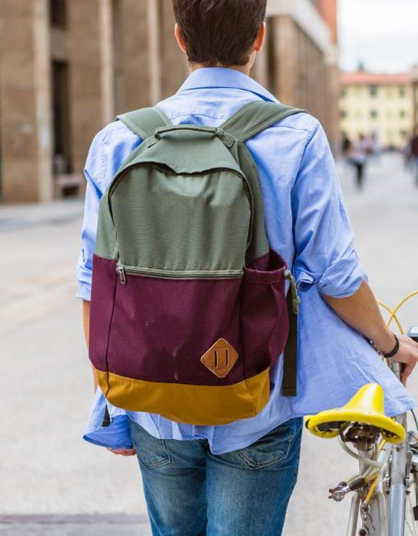
GETTING PICKED UP BY TRANSIT LINK
Transit Link drivers will arrive within 30 minutes of a scheduled pick-up time.
For example, if the scheduled pickup time is 1:00 pm, the vehicle will arrive between 1:00 pm and 1:30 pm and will be considered “on time” within that time frame.
Passengers have 3 minutes to board the bus once it arrives.
After that, the bus will depart, and the passenger will be considered a no-show. If a customer skipped the outgoing ride (a no-show), but still needs the return ride, the customer must call Transit Link to let staff know the return ride is still needed.
A rider may take Transit Link part of the way, along with a regular route bus to reach their destination.
Transit Link provides curb to curb service with limited assistance. If you are certified with Metro Mobility you may request door to door assistance.
Mask must be worn at all times.
All vehicles are equipped with lifts and have bike racks.
7

Slide 8
SCHEDULED PICK-UP TIME & PICK UP WINDOW
When you schedule your trip, a reservationist will provide you your pickup time. The pickup time is when you should be ready for the vehicle to arrive.
Your pickup time may or may not be the same as your requested pickup time.
Because Transit Link is a shared-ride service, we have a 30-minute window with which we can arrive. Please be waiting and watching for the full 30-minutes.
The vehicle should arrive within 30 minutes of the pickup time. It will be considered on-time if the bus arrives within 30 minutes of the scheduled time.
The “Appointment Time” is the latest time our vehicle should arrive at the destination address.
If you have an appointment, please consider the time you need to get from the vehicle to the appointment.
For example: If you have a doctor appointment at 10 am consider how long it will take to get to & from the doctor’s office building. If you are going to a large complex and it takes you 15 minutes to get from the vehicle to the doctor’s office, you’d should provide us with a 9:45 am appointment time.
8

Slide 9
Transit Link Fares & How to Pay
Peak Fares each way: $4.50 weekdays from 6:00 – 9:00 am from 3:00 – 6:30 pm
Off-Peak fares each way: $3.50
Holidays: $3.50 on Memorial Day (observed), Independence Day (July 4) , Labor Day, and the following Friday after Thanksgiving Day.
A 75-cent surcharge will be assessed for trips longer than 15 miles.
Children under the age of 5 ride free; up to 4 children can ride free.
Passengers may pay fares with cash, a Go-To Card with stored value or a transfer from a fixed route.
If the vehicle arrives more than one hour after the scheduled pick-up time, the ride will be for free.
Paying with Cash
Please have exact change. Drivers are unable to make change.
Paying with Go-To Cards
You can purchase Go-To cards at Metro Transit’s online store or at over 100+ retailers including all Cub Foods Stores.
9

Slide 10
Transfers
Customers may transfer between Transit Link and other transit services within the metro area. Transit Link passengers will transfer to regular route transit service at hubs, park-and-ride facilities and other approved locations such as Northtown Transit Center or a Cub Foods store.
You can request a transfer ticket from your driver. Transfers are valid for 2.50 hours.
If your trip starts on regular route transit, ask for a transfer ticket or retain your rail ticket.
If you start on Transit Link, paid with cash and are transferring to a fixed route, request a transfer from your Transit Link driver.
On any bus, if you pay with a Go-To Card, the transfer will be stored on your card.

Slide 11
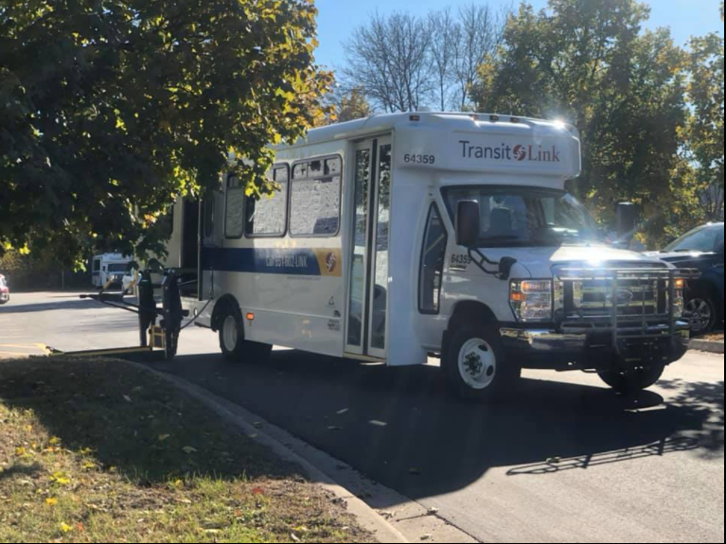
Standing Orders
Standing Orders are automatically scheduled trips that go to and from the same location, at the same time each week.
Customers can request a standing order by submitting a Standing Order Request form to the Provider after riding for three consecutive weeks. Some requests are not accepted based on capacity.
Customers can make up to four changes to an existing order each year. To make changes, the customer must contact the service provider at least 21 days in advance.
If a customer cancels or no-shows 50% of the time over a two-month period, the customer will receive a warning letter. Additional no-shows and canceled rides may result in the suspensions of the standing order.
11

Slide 12


No-Show Rules and Suspensions
Failing to cancel a ride at least one hour before the scheduled pickup time will result in a no-show. Three no-shows within 30 days will result in a warning letter.
Additional no-shows in the next 30 days could result in suspension from service and termination of any standing orders. A new standing order will not be granted for 12 months from the date that the previous suspension ended.
An outgoing trip, the return trip will automatically be canceled.
If the return trip is needed, the customer must contact Transit Link in order to reschedule the ride.
12

Slide 13


Let Metro Mobility and Transit Link Pick Up Your Groceries
Stay home and stay safe. Anyone can use Transit Link or Metro Mobility to order groceries and household essentials online from a store that has online shopping and local pick up. Transit Link will pick up your order and deliver to your house. The service is provided Monday through Friday between 6 a.m. and 7 p.m. and is free – no fares for delivery.
A minimum of 2 days notice is required.
Just tell the store Metro Mobility or Transit Link is picking up and provide us your order number for pick up.
Four-bag limit remains in effect.
Pickups must be scheduled at a commercial location and drivers will verify your photo ID at drop-off.
Contact Anoka County Transit Link at (651) 602 - 5465, press prompt 1, 1 and 1 again
Contact Metro Mobility at (651) 602 - 1111
Transit Link is also offering FREE Food delivery from local food shelves. You must schedule an appointment with the food shelf for a pickup time. The food shelf will coordinate with the Anoka County Transit Office.
13

Slide 14
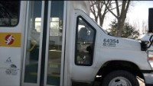

Slide 15
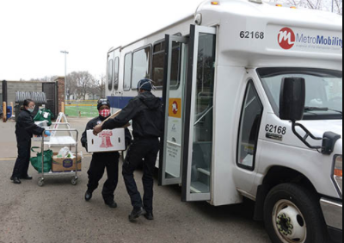
Food Shelves In Anoka County
Anoka County Brotherhood Council (ACBC)
North Anoka County Emergency Food Shelf (NACE)
Salvation Army Blaine
Southern Anoka County Assistance (SACA)
Centennial Community Food Shelf
15

Slide 16




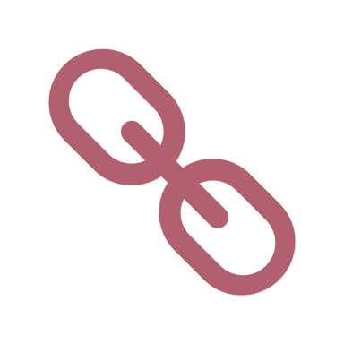
THANK YOU
Anne Walter
Transit Services Assistant
763 – 324 - 3106
Anne.Walter@co.anoka.mn.us
https://www.anokacounty.us/331/Traveler-Transit-Link

