Slide 1
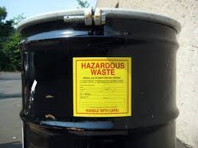
Hazardous Waste
Training
What is hazardous waste?
These are materials that your business will discard, or that you cannot use any more for their intended purpose, and that present risks to public health or the environment if improperly managed.
Updated 2023
Notes:
pd

Slide 2



Regulators
Environmental Protection Agency
(Enforces the Resource Conservation and Recovery Act)
Minnesota Pollution Control Agency
(Enforces Treatment, Storage, Disposal Facility (TSDF) Rules)
Anoka County Environmental Services
(Enforces Generator Rules)
Minnesota Administrative Rules
Chapter 7045, Hazardous Waste

Slide 3

We are here to HELP!
Enforces MN Hazardous Waste Rules and Anoka County Hazardous Waste Ordinance
● Follow-up on MN Duty Officer Reports
● Generator Licensing
Inspection Frequency
Large Quantity Generator (LQG) - two per year
Small Quantity Generator (SQG) - once per year
Very Small Quantity Generator (VSQG) - once per year
Class I Used Oil - every other year
● Complaint Inspections/Investigations
● Provides assistance on waste determination and disposal options
Assist operators on their Hazardous Waste
Annual Reporting
●

Slide 4
Hazardous Waste Generator Licensing Schedule
The licensing schedule applies to LQG, SQG, VSQG and Class I, Class II Used Oil Generators. To be eligible for an Anoka County hazardous waste generator license that is effective April 1 of each year, you must:
Submit the Hazardous Waste Annual Report and License Application
Pay your license fee
The hazardous waste generator license is valid from
April 1st – March 31st of the following year

Slide 5
Hazardous Waste Generator Licensing Schedule Continued…
MID December
The Hazardous Waste Annual Report and License Application are printed out and mailed to the generator by Anoka County Health Department (the Department).
JANUARY 31ST
The Hazardous Waste Annual Report and License Application is due.
Once the application is received by the Department, an invoice is mailed to the generator for license payment.
JANUARY – MARCH
Invoices issued before March 1st must be paid within 30 days.
March 31st
Invoices issued after March 1st must be paid by March 31st.
If the invoice is not paid by March 31st, generators are immediately considered operating without a license.

Slide 6
Updated MPCA Fact Sheets to Checkout!
Universal Wastes
https://www.pca.state.mn.us/sites/default/files/w-hw4-62.pdf
Firefighting Foam
https://www.pca.state.mn.us/sites/default/files/w-hw4-17.pdf
Infectious Waste – Vendors Approved in Minnesota
https://www.pca.state.mn.us/sites/default/files/w-sw4-34.pdf
Selling Mercury Cosmetics and Pharmaceuticals
https://www.pca.state.mn.us/sites/default/files/w-hw4-22.pdf
Selling Mercury Items
https://www.pca.state.mn.us/sites/default/files/w-hw4-26.pdf
Tire Transportation List
https://www.pca.state.mn.us/sites/default/files/w-sw6-03.pdf
Managing Sorbents: Towels, Wipes, and Rags
https://www.pca.state.mn.us/sites/default/files/w-hw4-61.pdf
Public Rulemaking Docket
https://www.pca.state.mn.us/sites/default/files/mm-rule1-00.pdf

Slide 7
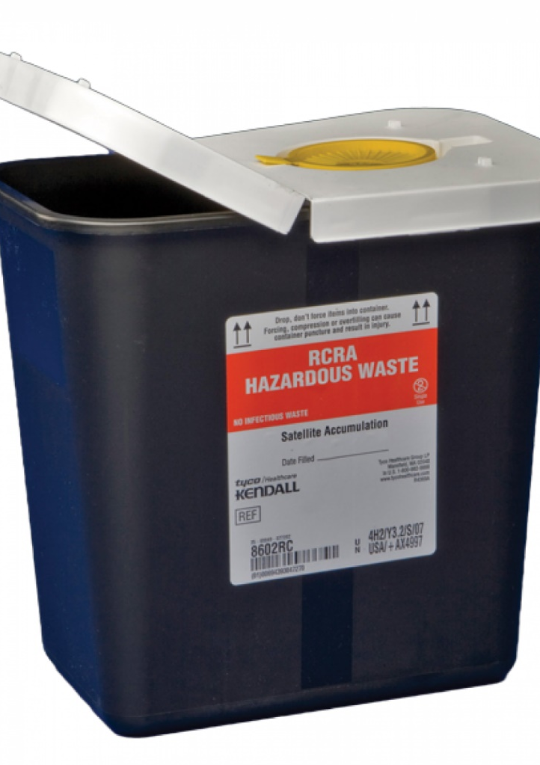
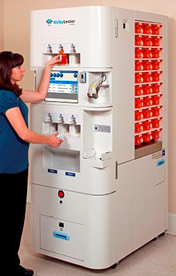
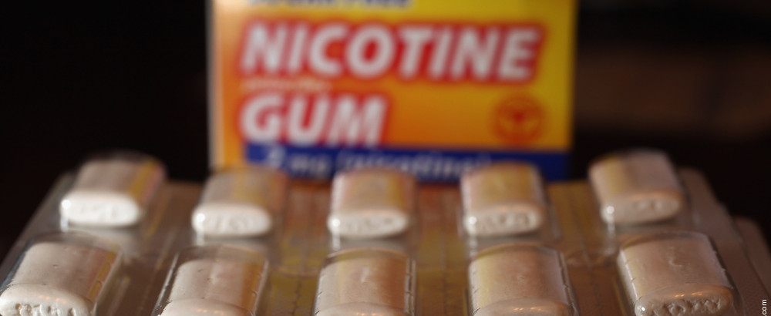
Changes in Pharmaceutical Waste Management
Fact Sheet Link:
https://www.pca.state.mn.us/sites/default/files/w-hw3-33.pdf

Slide 8
Been in Effect Since 2020
Fentanyl patches may be assumed non-hazardous in Minnesota.
Pharmaceutical stock and dispensing containers with a capacity of up to 10,000 tablets or 1 liter of liquid are exempt from hazardous waste requirements
Nonprescription (over the counter) nicotine replacement therapies are exempt from hazardous waste requirements.
Pharmaceutical wastes no longer “count” towards facilities generator size. Must still be annually reported with volumes and Anoka will still fee.
No longer need to separate the acute waste pharmaceuticals (P-listed) from hazardous waste pharmaceuticals, SQG and LQGs that generate pharmaceutical hazardous waste may accumulate and store up to one year and reverse distribution may be accumulated indefinitely.
Pharmaceutical waste containers no longer need to be marked with a date, but LQGs and SQGs must still be able to show that the waste has been accumulated for less than a year. Continue to label the storage containers as “Hazardous Waste” with a clear description that identifies the contents.

Slide 9
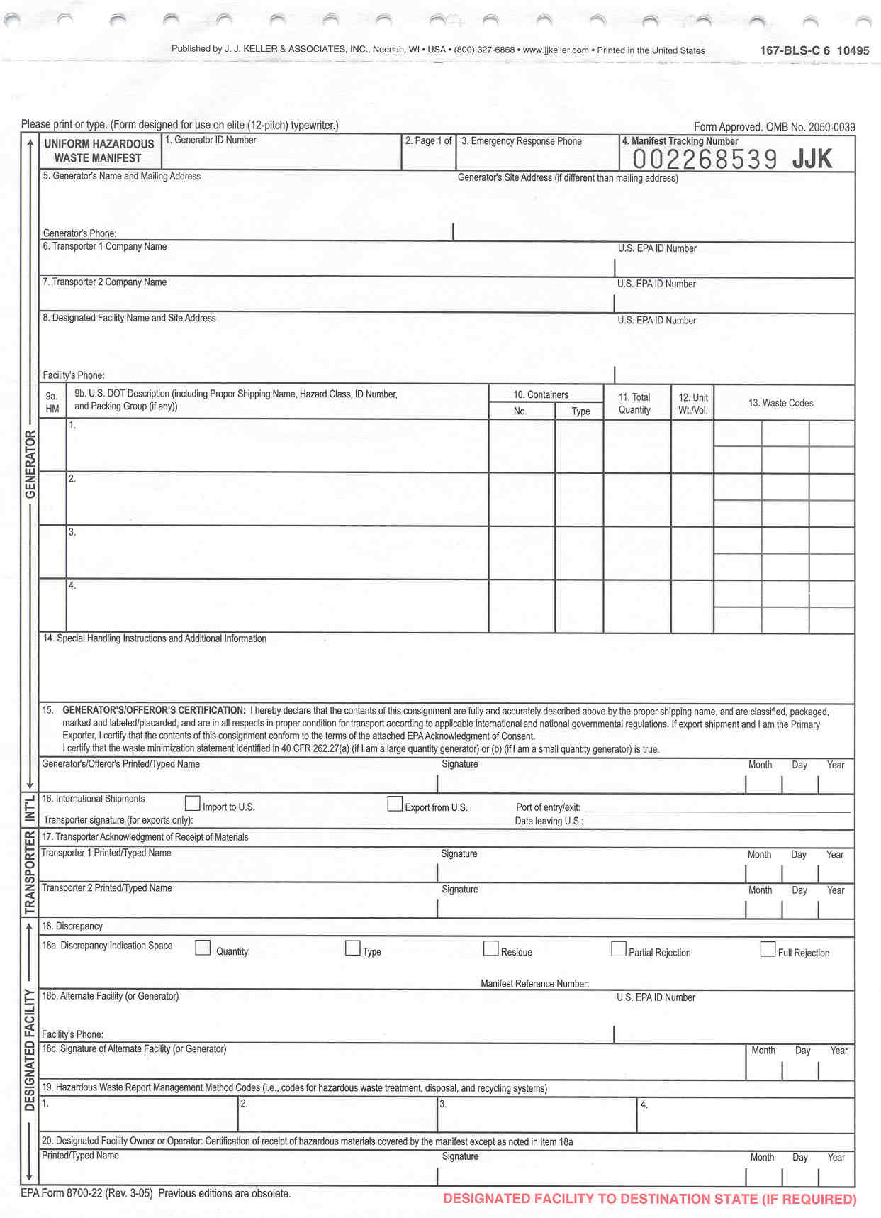
Pharmaceutical New Rule Affective in 2022:
Lethal pharmaceutical hazardous wastes will be prohibited from sewering for disposal
SQGS and LQGS that generate pharmaceutical waste will be required to provide at least one-time hazardous waste training to all employees who handle pharmaceutical hazardous waste
Pharmaceutical hazardous waste containers will be required to be secured or located in secured areas.
Pharmaceutical New Rule Affective in 2021:
Pharmaceutical wastes manifested off-site for disposal must list hazardous waste code “PHRM” on manifest
PHRM

Slide 10
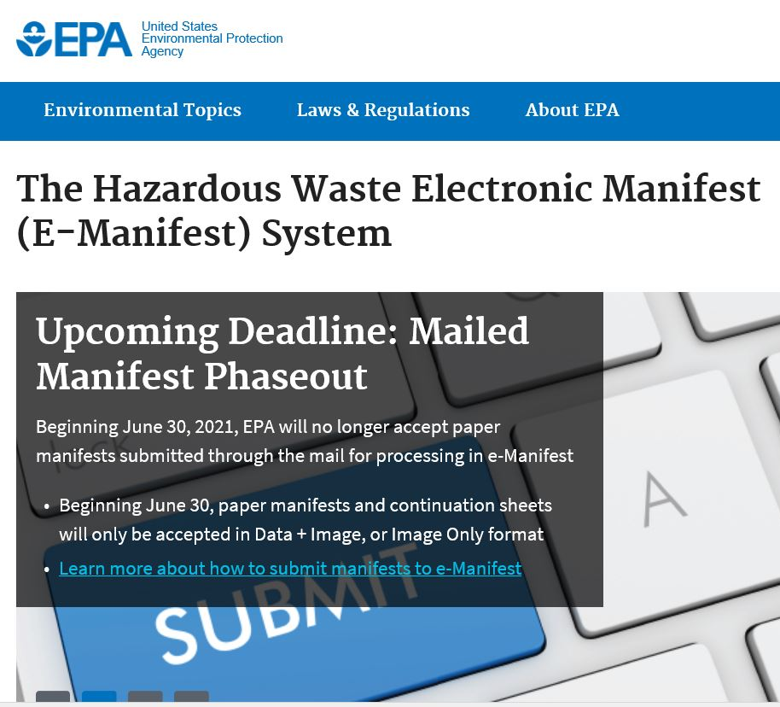
E-Manifest Information
You can now access your facilities manifest online!
Below is a link to RCRAInfo homepage to create an online account and gain access to your facilities manifests online.
https://rcrainfo.epa.gov/rcrainfoprod/action/secured/login
Additional Information about E-Manifest
https://www.epa.gov/e-manifest/learn-about-hazardous-waste-electronic-manifest-system-e-manifest

Slide 11
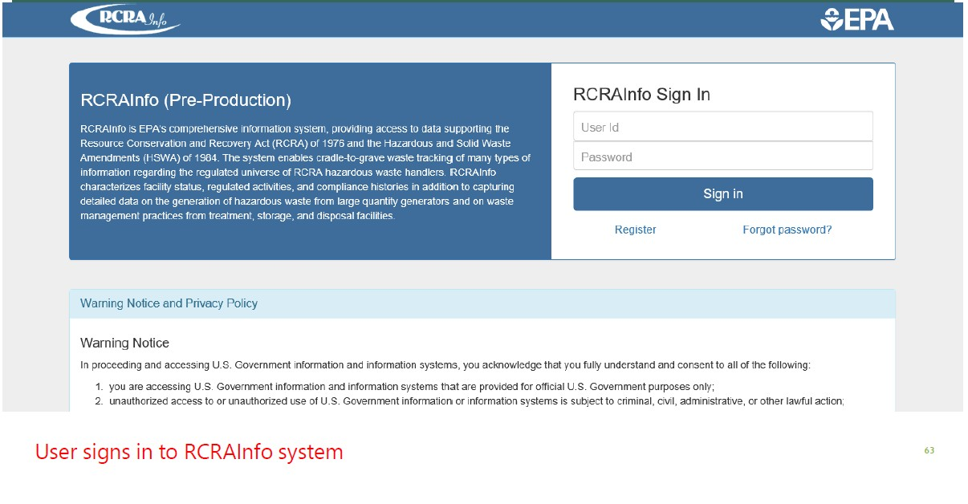
What to expect to see on the E-Manifest website

Slide 12
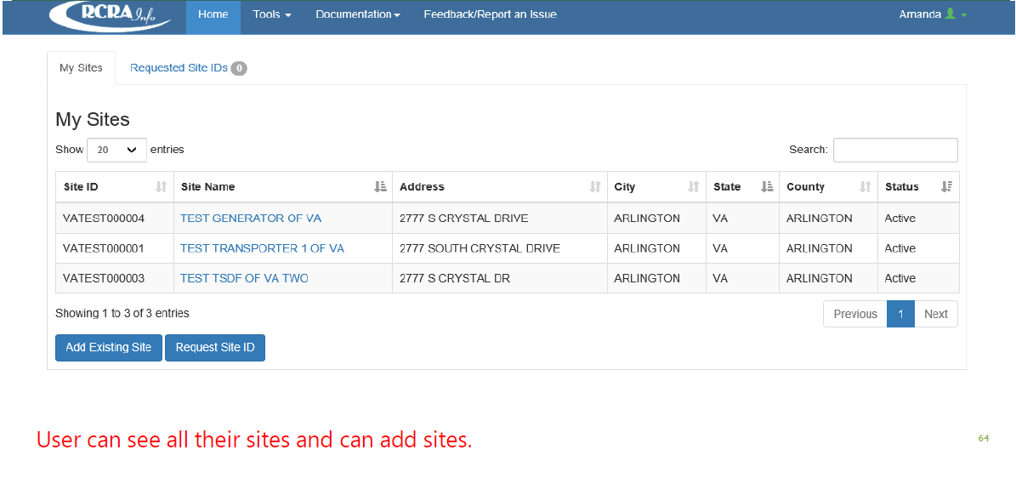

Slide 13
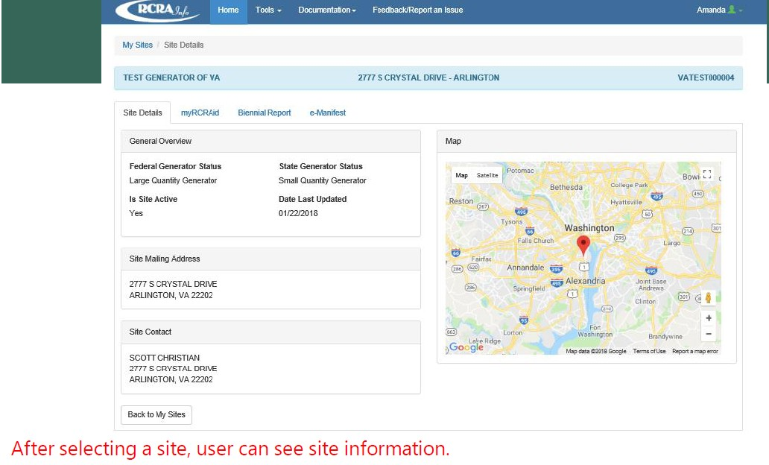

Slide 14
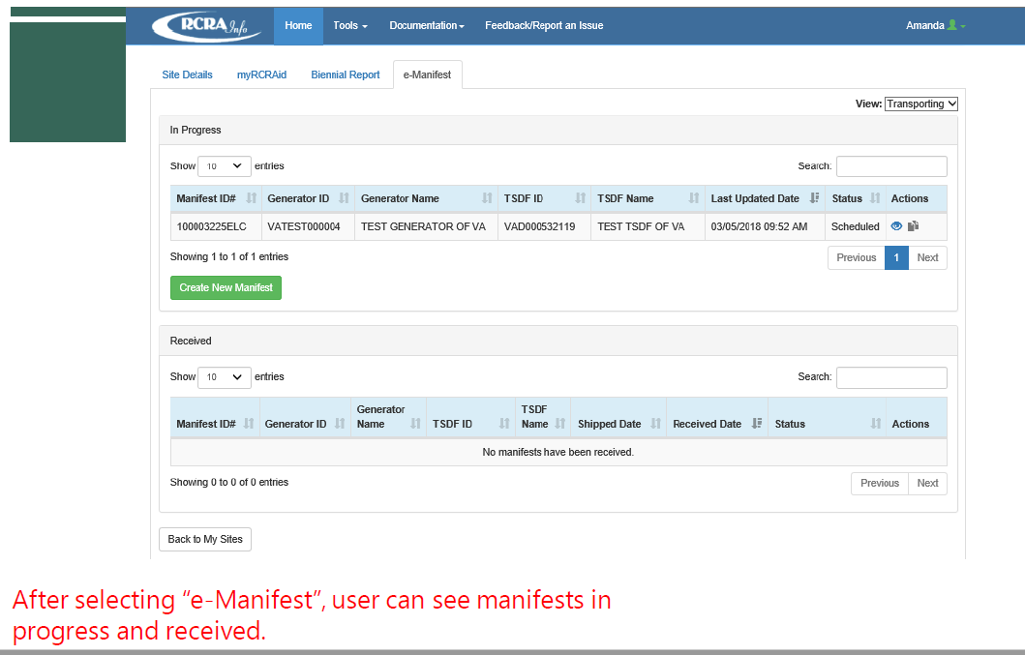

Slide 15
To help review the basic hazardous waste requirements, the MPCA has divided them into 10 individual steps known as the ‘10 Steps of Compliance’
Evaluate your waste
Determine your generator size
Obtain a hazardous waste identification number (HWID)
Complete a hazardous waste generator license application
Accumulate your hazardous waste at your site
Treat or transport your hazardous waste
Document your hazardous waste shipments
Plan for emergencies
Train your employees
Keep records
You Must Either:
Assume each of your wastes is hazardous unless….
You examine each of your wastes and document it as non-hazardous; that process is called evaluation.
If you do not evaluate and document a waste as non- hazardous, you must accumulate and dispose of it as a hazardous waste.

Slide 16
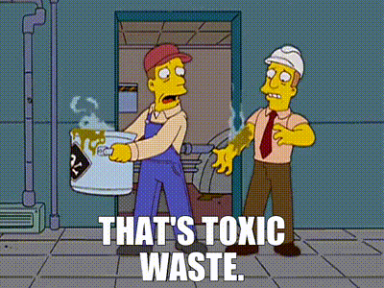
Step #1 – EVALUATE YOUR WASTE
10 Steps of Compliance
To conclude, if a waste is non-hazardous,
you must show the waste is not listed or PCB-contaminated
F-LISTED: specific sources https://www.pca.state.mn.us/sites/default/files/w-hw2-00.pdf
K-LISTED: specific sources https://www.pca.state.mn.us/sites/default/files/w-hw2-01.pdf
P-LISTED and F-LISTED OF ACUTLEY HAZARDOUS WASTE https://www.pca.state.mn.us/sites/default/files/w-hw2-02.pdf
U-LISTED: specific sources https://www.pca.state.mn.us/sites/default/files/w-hw2-03.pdf
PCBs: concentration over 50 ppm https://www.pca.state.mn.us/sites/default/files/w-hw4-48a.pdf

Slide 17
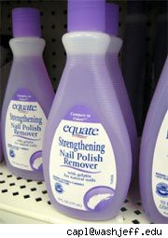
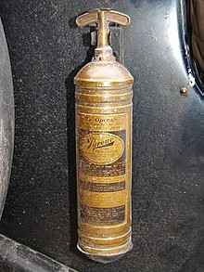
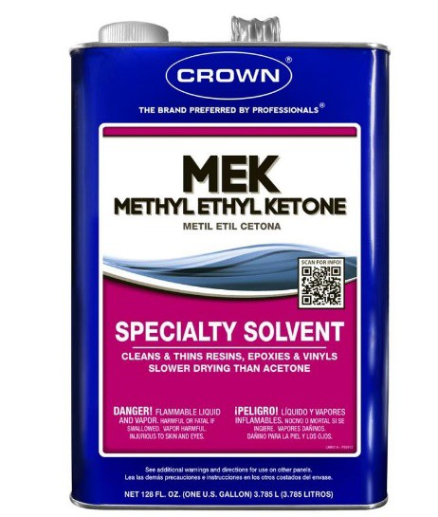
Examples of F Listed Hazardous Wastes
F003: Acetone F001: Carbon Tetrachloride F005: MEK (Methyl Ethyl Ketone)

Slide 18
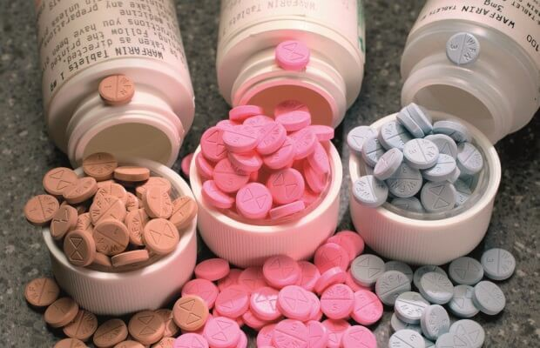
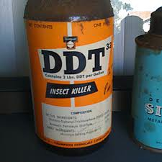
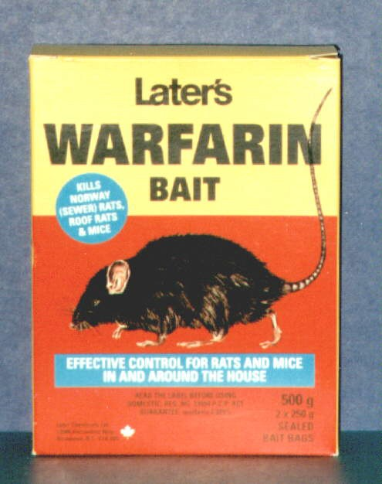


U Listed & P Listed Hazardous Waste examples:
U061: DDT P001: Warfarin
P075: Nicotine
U201: Resorcinol

Slide 19

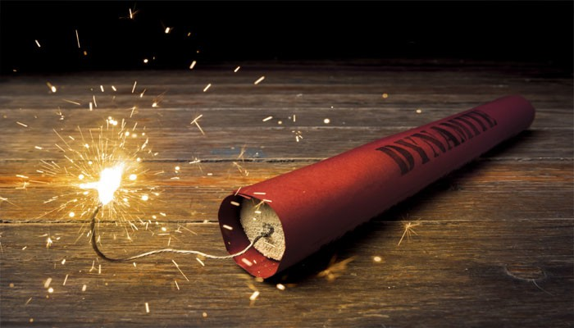
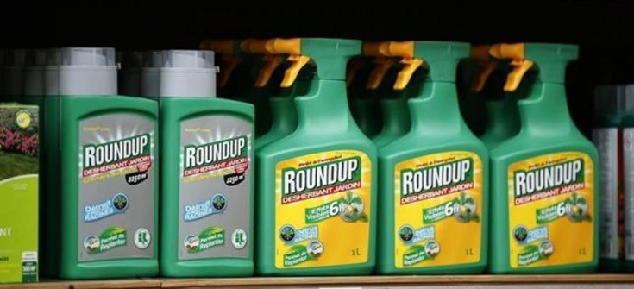

Examples of K Listed Hazardous Wastes
Explosives (K044-K047)
Pesticides (K031-K043, K097-K099, K123-K126, and K131-K132)
Wood preservation (K001)

Slide 20
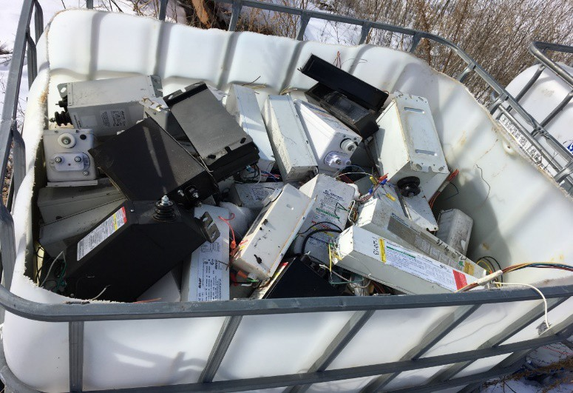
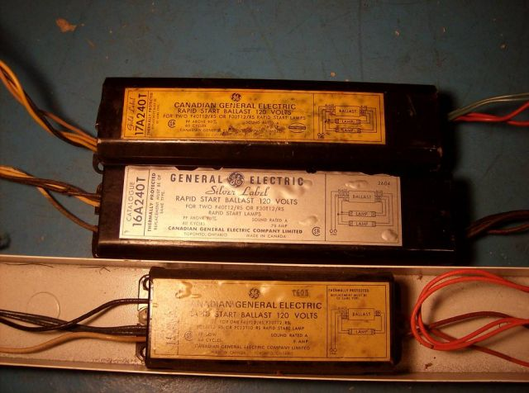
PCB Contaminated Waste
How can I tell if my ballasts and small capacitors contain PCBs?
You should assume all ballasts and small capacitors contain PCBs unless:
Labeled “No PCBs” or Known to be manufactured after 1979
Polychlorinated biphenyls (PCBs) are a class of 209 man-made chemicals with varying toxicity, often used as an insulator in electrical equipment.
The state regulates the storage and disposal of PCBs of ≥ 50 ppm (greater than) under the Hazardous Waste Rules when they become waste.
Identifying, using, & managing PCB Tips at the link below :
https://www.pca.state.mn.us/sites/default/files/w-hw4-48a.pdf

Slide 21
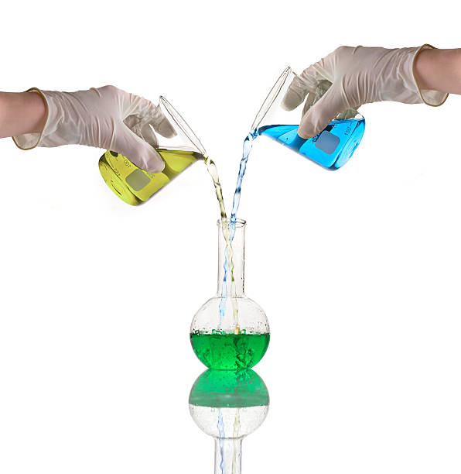
Mixing Listed Waste, What Happens When You Do?
Mixing a listed waste with other non-listed materials
will result in the whole mixture becoming a listed hazardous waste
Some Examples of Mixing:
Just so you know,
Neutralization is allowed, but dilution is an unacceptable form of treatment
Allowing to air dry in an open container is not acceptable!
Listed Rags & Oil Contaminated Rags
D001, F001 & F003 Listed Rags
with Toxic Listed Rags F001, F002, F004,
& F005
Water Based Paint & Oil Based Paint
(Liquid, Solid, or Rags)
Aqueous Parts Washer solution and Toxic
Brake Fluid
https://www.pca.state.mn.us/sites/default/files/w-hw4-61.pdf

Slide 22
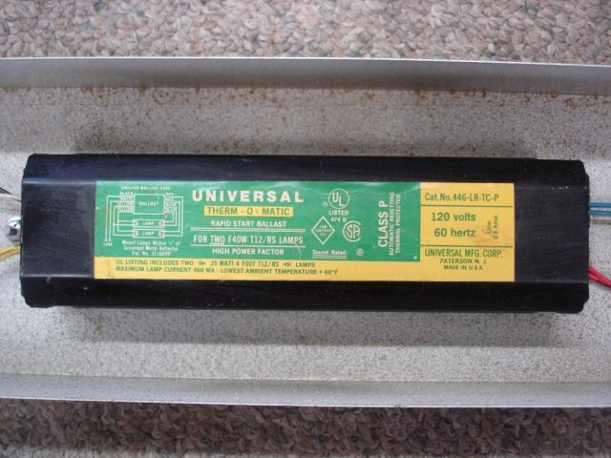
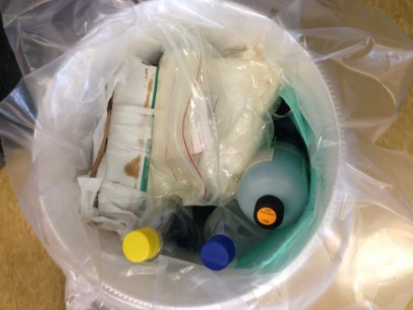
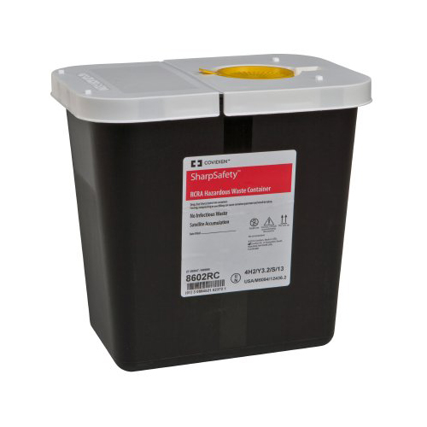
Minnesota – Specific Hazardous Waste
Definitions:
MNo1 - Lethality Characteristic
Oral (rat) LD ⁵⁰ ˂ 500 mg/kg
MN02 - Small amounts of compatible chemicals (labpack)
MN03- PCB Ballast
MN02-Lab Pack
MN03 – PCBs ˃ 50 ppm (polychlorinated biphenyls)
MN04 – Waste oil NOT recycled
PHRM -Waste Pharmaceuticals

Slide 23


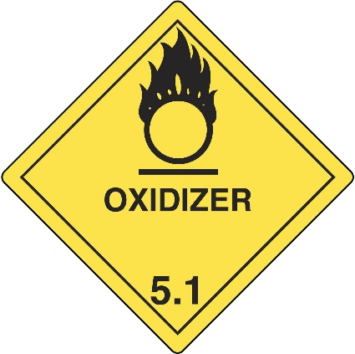

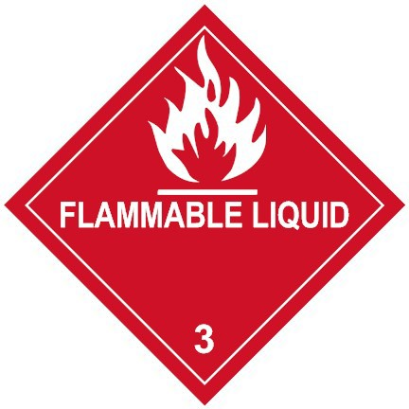
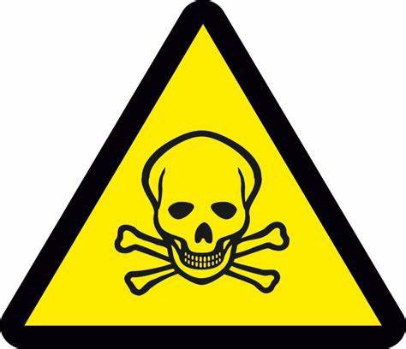
Hazardous Due to Characteristic
Ignitable : Flash Point < 140˚F
Oxidizer : Adds O2 to a Reaction
Corrosive : pH ≤ 2 or ≥ 12.5 or corrodes steel at 0.25 inches per year
Reactive: Unstable, Explosive
Lethal: Causes Death if eaten, inhaled, or absorbed
Toxic: Certain contaminants at or above maximum limits

Slide 24
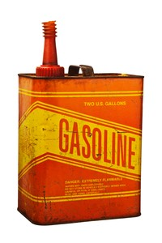
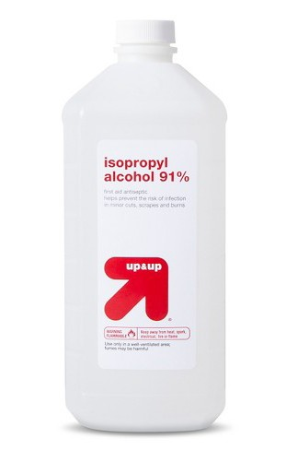
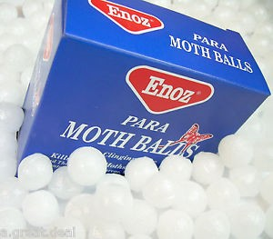
Hazardous Waste Characteristics
Ignitable (D001)
(examples)
A liquid with a flashpoint below 140˚ F
A nonliquid able to spontaneously
combust and burn persistently

Slide 25
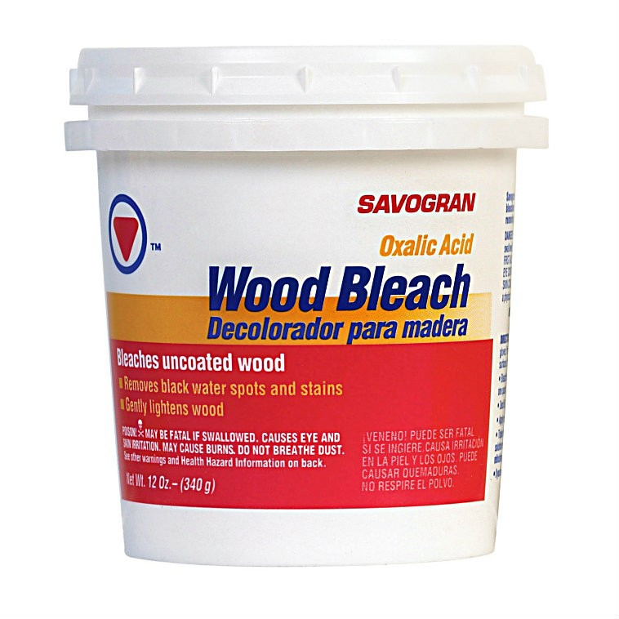
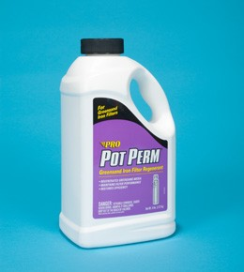
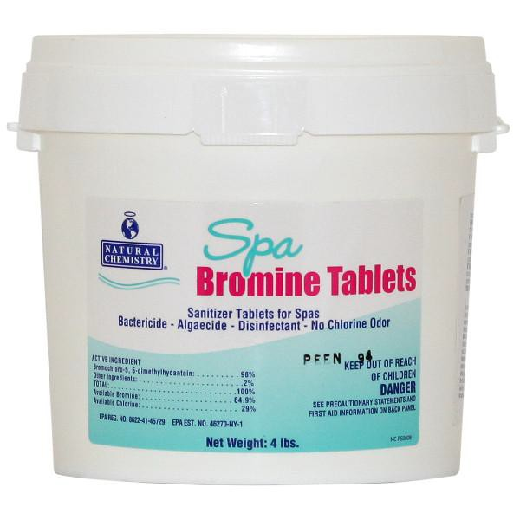
Hazardous Waste Characteristics
Oxidizer (D001)
(Examples)
A substance that supplies oxygen to a reaction in the absence of air.

Slide 26
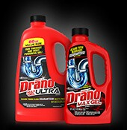
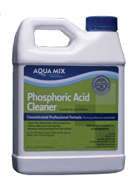
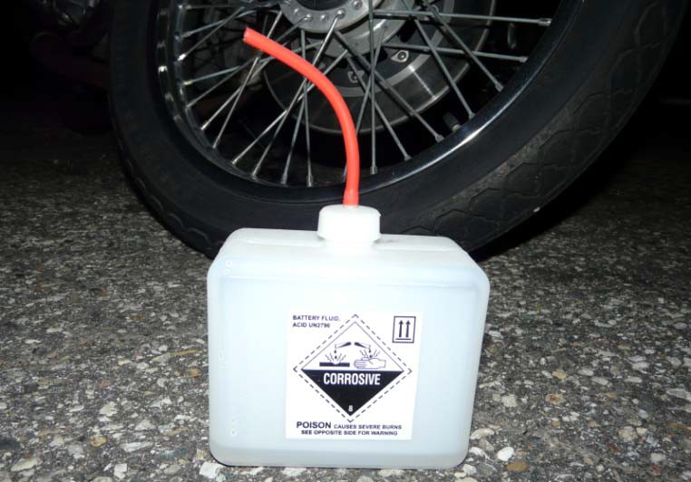
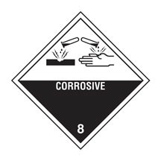
Corrosive (D002)
(Examples)
Hazardous Waste Characteristics
Strong Acids and Bases
Some Cleaners
Has a pH of 2.0 or less or greater than 12.5
Able to corrode steel at a rate
greater than ¼ inch per year

Slide 27

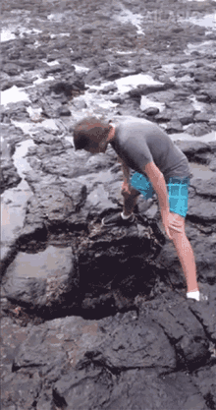
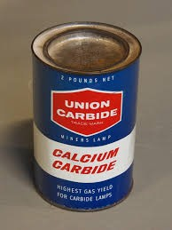
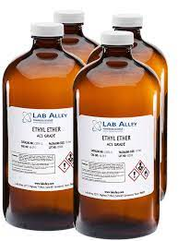
Hazardous Waste Characteristics
Reactive (D003)
(Examples)
A waste that is unstable, reacts violently, or forms potentially explosive mixtures when mixed with water
Or can produce toxic gases

Slide 28
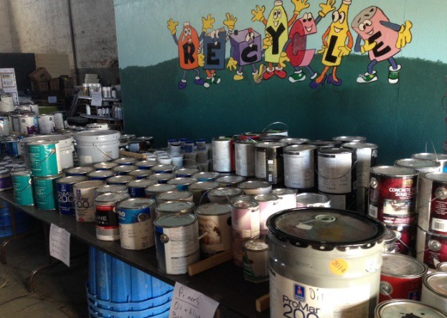
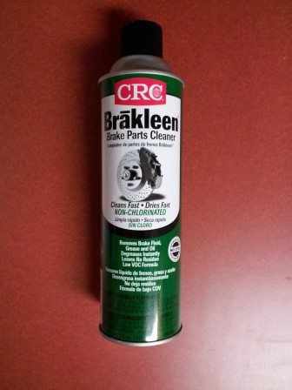
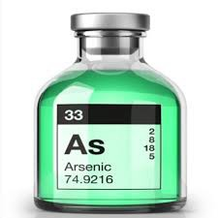

Hazardous Waste Characteristics
Toxic (Doo4-D043)
(Examples)
A waste containing hazardous contaminants above the maximum allowable concentration
Used photo fixer ( D011 Silver )
Lead ( D008 )
Mercury ( D009 )
Some paint related waste
Pre-1991, Latex Paint Contained Mercury (D009)
Barium (D005)
Arsenic (D004)
Tetrachloroethylene (D039)

Slide 29
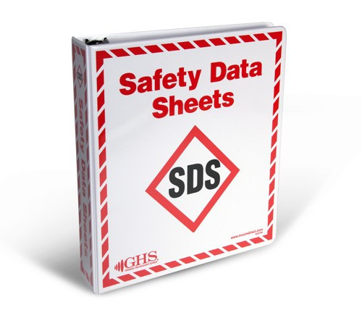
Evaluate the Waste ( What is it? )
Check the Raw Materials
Safety Data Sheets (before use)
Product Supplier or Manufacturer knowledge
Identify what happens in the waste producing process
If you cannot classify the waste, test a sample
Retest of a waste is not required unless the product or process changes
Keep test results on-site for inspection

Slide 30
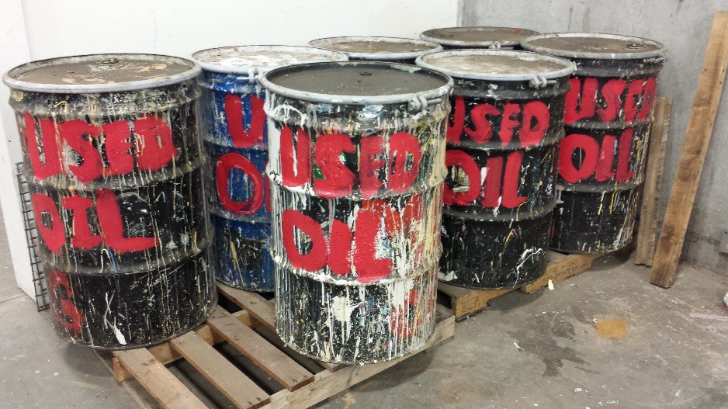
To Determine the Status of a Waste,
You Need to Check:
Is it a Listed Waste?
F, K, P, U
Does the waste contain more than 50 ppm PCBs?
Is it a Characteristic Waste?
Ignitable Oxidizer
(D001)
(D001)
Is it used oil or used oil related wastes?
Corrosive (D002)
Reactive Toxic Lethal
(D003) (D004-43) (MN01)

Slide 31
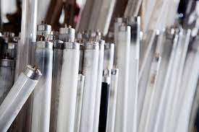
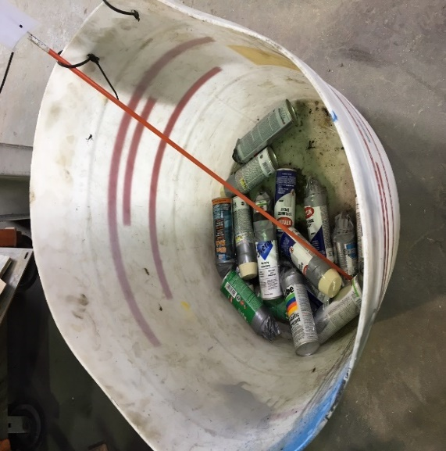
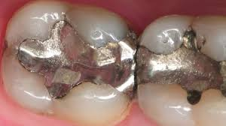
Additional Hazardous Waste: Universal Wastes
What is Universal Waste?
UW are a subset of hazardous wastes that may be managed under reduced requirements.
Minnesota Specific Waste?
Dental amalgam being recycled
Pretreated dental wastewater
Aerosol containers and compressed gas cylinders
Almost every business generates them at some point :
˖Lamps
˖Pesticides
˖Batteries
˖Mercury-containing equipment
- Aerosol cans

Slide 32
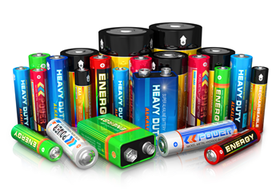
Universal Wastes:
Non-hazardous, but can still be recycled
UW Batteries, must be recycled
Alkaline
Carbon Zinc
Chloride Zinc
Nickle Metal Hydride
Zinc Air
Include any electrochemical storage devices that consist of anode, cathode, and electrolyte and would be considered hazardous waste when discarded, including disposable and rechargeable categories: lead acid, nickle-cadium (Ni-cd, Nicad, lithium, lithium-ion, silver containing, & mercury containing batteries.
Lead acid batteries must be placed in an impermeable
container and labeled as “Used” or “waste lead acid batteries

Slide 33

Universal Wastes:
Pesticides from Businesses
Only recalled pesticides and pesticides collected under a waste pesticide collection program are eligible to be managed as universal wastes.
All other pesticides not managed with a registered pesticide collection program must be managed as hazardous waste and reported on the facilities hazardous waste annual report.

Slide 34


Universal Wastes:
Mercury-Containing Equipment
Mercury Switches
Mercury Batteries
Manometers
Blood Pressure Cuffs
Mercury Temperature Probes
Mercury Thermometers
Mercury Barometers

Slide 35




Universal Wastes:
Lamps
Fluorescent
Neon
Mercury Vapor
High Pressure Sodium
Metal Halide Lamps
Green Tip Lamps

Slide 36


Universal Wastes:
Extracted teeth containing amalgam are not considered infectious waste in Minnesota.
Dental Amalgam
Includes:
Amalgam Capsules
Extracted Teeth
Filter Trap Waste
Separator Sludge

Slide 37

Universal Wastes:
Pretreated Dental Wastewater is..
Mercury - containing – even if it has previously gone through an amalgam separator, transported or discharged to a publicly owned treatment work’s or VSQG collection site.
Do not discharge to a septic system
Amalgam Separator

Slide 38




Universal Wastes:
Waste Aerosols & Compressed Gas Cylinders
Waste aerosols/gas cylinders may be punctured as long as liquids are collected.
Partially full aerosol cans are
classified as universal waste, paint waste from puncturing must be managed as hazardous waste.

Slide 39


What is NOT a Universal Waste
Non-hazardous Batteries
Electronic Waste
Architectural Paint
PCB Containing Ballasts and Small Capacitors
Used Oil
Examples of electronic waste (E-Waste) and labeling of E-waste

Slide 40


EXEMPT From Fully Regulated Hazardous Waste
Used Oil

Slide 41




Used Oil Labeling
Do not label used oil storage containers as WASTE OIL
7045.0855, Subpart 2.C
STANDARDS FOR USED OIL GENERATORS
Containers, aboveground tanks, and fill pipes of underground tanks used to store used oil at generator sites must be marked with the words "Used Oil."

Slide 42


What is Considered Used Oil ?
Very Small Quantity Generators may mix a maximum of 10% of petroleum-based solvents into used oil as a disposal method

Slide 43

Step #2 Determine your generator size
Generator size is based on the volume (gallons or pounds) and type of hazardous waste generated at a site for each calendar month
Do not count the weight of the container: only count the mass of hazardous waste or residue in a container.
If your site generates: Then your site’s generator size is:
Less than 220 pounds per month and less than 2.2 pounds per month of acute hazardous waste
Very Small Quantity Generator (VSQG)
Between 220 to 2,200 pounds per month and less than 2.2 pounds per month of acute hazardous waste
Small Quantity Generator (SQG)
More than 2,200 pounds per month or more than 2.2 pounds per month of acute hazardous waste
Large Quantity Generator (LQG)

Slide 44

Step #3 Obtaining a Hazardous Waste Identification Number (HWID)
Check out the MPCA Fact Sheet to learn more about E-Services
What is a Hazardous Waste Identification Number (HWID) ?
A hazardous waste identification number
(HWID) is a unique number used to simultaneously identify both a physical location at which hazardous waste is generated or handled and the operator of that site. The Minnesota Pollution Control Agency (MPCA) assigns HWIDs in Minnesota. The U.S. Environmental Protection Agency (EPA) coordinates the numbering system nationwide, HWIDs are also referred to as EPA ID’s.
https://www.pca.state.mn.us/sites/default/files/w-hw5-12.pdf
https://www.youtube.com/watch?v=aqgKP5LNsEo
The HWID # is not transferable from location to location

Slide 45

How do I obtain a HWID?
The MPCA has an online e-services Notification of Regulated Waste Activity tool at https://www.pca.state.mn.us/sites/default/files/w-hw5-12.pdf
You must submit an inactivation notification for the site using the MPCA E-Services Notification of Regulated Waste Activity tool. HWID are site- specific and cannot be transferred or moved to a new site. Obtain a new HWID for the new site using E-Services.
What do I do with my HWID if I move, sell or close a business?

Slide 46


Step #4 Complete a Hazardous Waste
Generator License Application
Hazardous waste generator license application & the hazardous waste disclosure form is a
on the Anoka County Environmental Services website:
https://www.anokacounty.us/DocumentCenter/View/2844/Hazardous-Waste-License-App-and-Disclosure-Form-PDF
You can email or mail in a copy of the completed application to Environmental.Health@anokacounty.us or mail it in to 2100 3rd Ave N Suite 600 Anoka, MN 55303

Slide 47

Step #5 Accumulate your hazardous waste at your site
Very Small Quantity Generators (VSQGs) can accumulate up to 2,200 pounds of waste. That is about four full 55-gallon drums!
VSQGs can store waste indefinitely, until the accumulation exceeds 2,200 pounds, then waste must be of off site within 180 days from accumulation start date.
About four 55-gallon drums at one time = 2,200 pounds
Very Small Quantity Generators

Slide 48
Step #5 Accumulate your hazardous waste at your site
Small Quantity Generators (SQGs) can accumulate up to 6,000 pounds. That is twelve full 55-gallon drums!
SQGs must remove drums off site within 180 days from the accumulation start date
Accumulate about twelve full 55-gallon containers = 6,000 pounds
Small Quantity Generators

Slide 49

Step #5 Accumulate your hazardous waste at your site
Large Quantity Generators (LQGs) can accumulate any amount of waste on site.
LQGs must dispose of waste within 90 days from the accumulation start date
Large Quantity Generator

Slide 50

Acute Hazardous Waste
(Examples)
Warfarin
Acute hazardous waste have more complex accumulation requirements. If facilities generate more than 2.2 pounds (1 quart) of this waste per month, the facility is classified as LQG. Anything less than 2.2 pounds of acute waste per month is classified as a VSQG.
Nicotine
( E-cigarette mixed liquids)

Slide 51
Accumulation Start Date
Date the first drop of hazardous waste is placed into a storage container.
NOTE: VSQGs and SQGs may retain hazardous waste for an additional 90 days (for a total of 270 days), if the designated facility for the waste is located more than 200 miles from the generation site.
The generator must request an extension with the Minnesota Pollution Control Agency before exceeding the accumulation limits. More information about requesting an extension is listed at the link below: https://www.pca.state.mn.us/sites/default/files/w-hw1-05e.pdf

Slide 52
Satellite Accumulation
What is a Satellite? A satellite container allows a generator to accumulate waste without a time limit of 180 days or 90 days. The time limit starts once the satellite containers full and then dated with the filled date. The newly dated container has three days to be moved to the hazardous waste storage area.
This allows you to accumulate up to 55 gallons of most hazardous wastes or 1 quart of acute hazardous waste without attaching an accumulation start date to the container or counting towards your accumulation volume limit.
Accumulation start date begins once satellite container is full.
Satellite accumulation containers must be:
Within the immediate working area of the process generating the waste and under the direct physical and visual control of the operator of that process.

Slide 53



What Can You Accumulate Hazardous Waste In?
Hazardous waste may be accumulated in either a portable or stationary container.
Containers and tanks must be:
In good condition & leakproof
Compatible with the waste they hold
Strong enough to contain the waste they hold; for containers even if dropped while filled
Labeled

Slide 54

How should a Hazardous Waste label look
on containers and tanks?
1. Words “Hazardous Waste”
2. Description that clearly identifies the contents to employees and emergency responders. For example: Flammable liquid
3. Accumulation Start Date: the date in which the first drop of waste is placed into the container.
Satellite containers dated immediately once classified as full. (Facilities can only have up to 55 gallons of one waste material as a satellite.)
NOTE: Hazardous waste labels do not have required colors, format, or size but must be clearly visible without moving containers. If it is not reasonably possible to see the label on a specific container or tank, keep the label information in a clearly visible designated record in the immediate area.

Slide 55




Can you keep hazardous waste containers
open?
No, you must keep hazardous waste containers closed at all times, except when adding or removing waste from the container.
Closed means that the lid of the container is secured such that no waste would be released if the container were dropped or overturned.
Physical fastening is required; lids that shut by gravity alone is not sufficient.

Slide 56

Step #6: Treat or Dispose of Hazardous Waste
Prohibitions:
Without authorization from the Minnesota Pollution Control Agency or Anoka County, some practices are strictly prohibited.
It is unlawful to use the following methods to treat or dispose of hazardous waste:
Burn
Evaporate
Dump
Dilute to dispose
Mix to dispose

Slide 57

Step #6: Treat or Dispose of Hazardous Waste
Sewering Waste
Discharging hazardous waste to a sanitary sewer is allowed IF:
The public owned treatment works (POTW) or sewering authority has been notified.
All conditions imposed by the POTW are met.
You cannot dispose of hazardous waste to a septic system or an individual site treatment system unless first approved by the MPCA.

Slide 58

Step #6: Treat and Dispose of Hazardous Waste
VSQG Parts Washer Mixing Exception:
VSQGs may mix hazardous waste parts washer solvent into their used oil for disposal IF:
The used hydrocarbon solvent is:
Not Gasoline
Not Chlorinated
Not Paint or thinner waste
Mixed to ≤10% Record each time you mix that includes:
The date
The volume of parts washer solvent used in mixture
The volume of used oil into which the solvent was mixed
Keep records of manifest for at least three years

Slide 59

Step #6: Treat and Dispose of Hazardous Waste
Recycling/Reusing Hazardous Waste as a treatment or disposal of waste:
You may also send the waste off- site for recycling as your facilities treatment or disposal method.
Recycled waste are not always exempt from license feeing.
Generators should be aware of sham recyclers. (“Recyclers” that do not meet standards of recycling).
Hazardous Waste Generators may treat their own hazardous waste on-site
Some on-site treatment practices:
Neutralization of corrosive wastes
De-watering of aqueous hazardous wastes
Mixing resins/hardeners that are hazardous waste before use
Chemical fixations

Slide 60

Step #6: Treat and Dispose of Hazardous Waste
Shipping Waste:
Department of Transportation requirements: be aware that shipping offsite as a treatment and disposal method, you are responsible for: Ensuring the driver is properly licensed, containers DOT-labeled, and containers secured. As the generator you remain responsible for them in partnership with the transporter.
It is a great idea to get a transporter you trust. The MPCA strongly suggests looking into the transporter before contracting them.
Check license/permits, references, talk
to other businesses, contact regulatory agencies, visit their storage or consolidation location.
Check out Anoka County’s approved transporter list here

Slide 61


Step #7: Documenting Your Hazardous Waste
What is a Hazardous Waste Manifest?
A record used to track hazardous waste shipments from the site where the waste was generated to its final recycling or disposal facility. This is known as cradle-to-grave tracking.
Hazardous waste generators remain liable forever for any mismanagement of their waste, even after it leaves their site. Manifests help provide generators and transporters with liability protection by documenting the waste reached its intended destination.

Slide 62

Step #8: Emergency Planning
What are my Emergency Planning and Response requirements ?
An internal public address or alarm
External Telecommunications
Internal communication – facility must provide emergency call equipment or procedures such as “buddy system”

Slide 63


Step #8: Emergency Planning
What Are My Emergency Planning and Response Requirements?
Employee decontamination equipment
Equipment must be accessible.
Equipment must be appropriate to the types and volumes of waste.
Designate an emergency coordinator
Knowledgeable about the site
On site or reachable in case of emergency
Required for SQGs and LQGs

Slide 64
Hazardous Waste Contingency Plan (LQGs Only)
Respond & Report: Activate your contingency plan and submit a written report to the MPCA or Anoka County
Immediately report all spills that may reasonably reach the environment to the Minnesota Duty Officer (MDO).
When preparing your Hazardous Waste Contingency Plan, keep in mind the plan must include:
All emergency contacts and addresses
A list of all emergency equipment
Evacuation procedures
An attempt to make emergency arrangements with all the local response agencies

Slide 65

Step #9: Employee Training
The Minnesota Pollution Control Agency and Anoka County encourage every employee with hazardous waste-related duties be trained.
This includes employees who just sign off on a manifest.
VSQGs are not required to provide hazardous waste training under Minnesota Hazardous Waste Rules.
However, you may be required to train your employees under the regulations of the U.S. Occupational Safety & Health Administration (OSHA) and the U.S. Department of Transportation (DOT).

Slide 66
Step #9 Employee Training
SQG Training Requirements
Small Quantity Generators must provide hazardous waste training to employees who are:
Generating or handling hazardous waste
Preparing hazardous waste-related records (manifests, inspection logs, etc.)
Designated to respond to or manage hazardous waste spills and incidents
SQGs only need to go through training once.
Keep all hazardous waste training records received by employees for at least three years after they stop all hazardous waste-related duties.

Slide 67
Step #9 Employee Training
LQG Training Requirements
Your hazardous waste training program must be directed by a hazardous waste training program director who is trained in hazardous waste management.
The program director does not have to be an employee HOWEVER:
They must be familiar with all aspects of your site, processes, and procedures.
Training they prepare must be based on your site’s practices; generic hazardous waste training alone is NOT sufficient.
LQG’s must be trained every year.
Ensure training records include:
Names of individual employee’s trained
Date(s) training was provided
Description of the content of the training.

Slide 68
LQG Training Requirements
Complete all these training steps:
List each job title that includes hazardous waste-related duties
Prepare a written job description for each position identified in #1 that includes:
Draft a hazardous waste training plan for each job description.
Must be specific to job description
Identify the content and type of both initial & refresher training required for the position
Provide training described in each job description’s hazardous waste training plan within the time limits discussed.
Document the training provided to each position identified in #1 that includes:
Name of employee filling position
Date employee began hazardous waste duties in the position
Date training was provided
I.
II.
I.
II.
Normal hazardous waste-related duties
Emergency duties:
Including those described in the site’s contingency plan
Required job qualifications, skills, & education
III.
I.
II.
III.

Slide 69

Step #10 Hazardous Waste Records
All Generators must retain:
Hazardous waste manifests & exception reports
Weekly inspection logs
Used oil shipment receipts
Universal waste records
Electronic waste disposal records
Documentation of waste evaluated as non-hazardous
On-site hazardous waste treatment logs if applicable
Feedstock & byproducts recycling verification records
NOTE: All records must be kept for at least three years.

Slide 70

Step #10 Hazardous Waste Records
Must be available during regular business hours
2. Must be provided even if record managers are not present
3. Records can either be stored as a:
●Hard Copy
●Electronic Copy

Slide 71




Special Topics
Rags/Sorbents
Used Oil Related Wastes
PCB Ballasts & Capacitors
Electronic Waste

Slide 72

Electronic Waste
What are Electronic Wastes?
Cathode-ray tubes
LED lamps
Circuit-board containing devices:
Computers (desktops, laptops, pads)
Printers
Keyboards, Mice
Telephones (desk & cellular)
E-readers
Medical equipment
Industrial control equipment

Slide 73

Electronic Waste
How should I manage electronic wastes?
Recycle, or manage as hazardous waste
Store intact or in closed container
Label container or each item
“Electronic Waste” or “Electronic Waste for Recycling”

Slide 74



PCB Ballasts & Capacitors
Fluorescent lamp ballasts & small motor capacitors
Manage under TSCA requirements
Managing PCBs in Ballasts and Small Capacitors https://www.pca.state.mn.us/sites/default/files/w-hw4-48a.pdf
Report as hazardous waste
Assume it’s PCB-containing equipment unless it’s:
Marked or labeled “Non PCBs”
Known to be manufacture after 1979

Slide 75



Used Oil Related Wastes
Used Oil Filters
Used Floor Dry
Oily Rags, other absorbents
Crankcase/engine oil
Hydraulic Fluid
Oil-based coolant
Cutting oil

Slide 76


Used Oil Related Wastes
Used Oil Storage Requirements:
Closed, leak-proof containers
Store on impermeable surface
Asphalt is not impermeable
Label “Used Oil”.
filters
absorbents
rags

Slide 77

Used Oil Related Wastes
Used Oil Tanks
Label the tank and fill pipes “USED OIL”
Register with MPCA if tank capacity exceeds 500 gallons
Ensure filling does not release oil

Slide 78


Management of Used Oil Related Wastes
DON’T:
Place in solid waste
Dump on ground
Discharge to sewer
Burn unless approved burner
DO:
Recycle
Burn for heat in approved burner
Ship with registered used oil hauler
Drain filters & sorbents before shipment

Slide 79

Used Oil Related Wastes
Used Oil generators MAY take their used oil to another business IF:
The other business agrees in writing to accept the used oil.
The shipments are less than 55 gallons.
The oil is not burned without testing it first.
Generator should keep a log of how much oil they generate if they are disposing their waste at a business and not with a licensed waste disposal company.

Slide 80
Management of Rags/Sorbents
Don’t:
Place in solid waste
*Except D001/F003 listed rags dry from use; commercial incineration is preferred over landfill
Air-dry
Burn
Do:
manage liquid as hazardous waste
Launder and reuse if possible
*Ensure laundry can safely launder reusable sorbents
Store in labeled, fire-proof container
Dispose of non-reusable sorbents as hazardous waste
Toxic Solvents include: F001, F002, F004, and F005 –
These rags must be treated,
managed, and labeled as hazardous waste!

Slide 81


Rags/Absorbents
Ignitable-Only Rags/Sorbents D001/F003 listed
Non-hazardous if they don’t contain free liquids
May be disposed of as industrial solid waste
(always double check with solid waste provider before placing in the garbage for disposal)
Store sorbents in flammable cans
No labeling is required
Anoka County encourages a descriptive name on a label such as “Ignitable Only Rags” or a pictogram.

Slide 82

Rags/Absorbents
Hazardous Waste Rags/Sorbents
Toxic solvents – All other F-listed solvents
Must be stored in a closable container labeled as hazardous waste, with a descriptive name and an accumulation start date.
Portable cans designated as satellite containers do not need an accumulation start date

Slide 83


Rags/Absorbents
Oil Contaminated Only
Store in closable waste can
Label as:
Used Oil
Used Oil (type of waste)
Keep receipts of disposal

Slide 84
Congratulations!
You’ve completed the online hazardous waste training
Please complete the 10-question quiz. You will need a passing percentage of 80% in order to receive a completion certificate and a copy of the training. Please keep certificates and training documentation on- site for your facilities routine hazardous waste inspections!
Link to the quiz is available here or on the HazWaste Generator Training webpage.
Please contact Tom Olson via email at tom.olson@anokacountymn.gov or by phone 763-324-4243.

